Slide 1
Chapter 16 – Files and Streams
Outline
16.1 Introduction
16.2 Data Hierarchy
16.3 Files and Streams
16.4 Creating a Sequential-Access File
16.5 Reading Data from a Sequential-Access File
16.6 Updating Sequential-Access File
16.7 Random-Access File
16.8 Creating a Random-Access File
16.9 Writing Data Randomly to a Random-Access File
16.10 Reading Data Sequentially from a Random-Access File
16.11 Example: A Transaction-Processing Program
16.12 Class File

Slide 2
16.1 Introduction
Files
  Long-term storage of large amounts of data
  Persistent data exists after termination of program
  Files stored on secondary storage devices
    Magnetic disks
    Optical disks
    Magnetic tapes
  Sequential and random access files

Slide 3
16.2 Data Hierarchy
Smallest data item in a computer is a bit
  Bit can be either 0 or 1
  Bit short for “binary digit”
Programmers work with higher level data items
  Decimal digits: (0-9)
  Letters: (A-Z and a-z)
  Special symbols: (e.g., $, @, %, &, *, (, ), -, +, “, :, ?, /, etc.)
  Java uses Unicode characters composed of 2 bytes
    A byte is normally 8 bits long
Fields (Java instance variables)
  Composed of characters or bytes
  Conveys meaning

Slide 4
16.2 Data Hierarchy
Data hierarchy
  Data items in a computer form a hierarchy
    Progresses from bits, to characters, to fields, etc.
Records
  Composed of several fields
  Implemented as a class in Java
  See Fig. 16.1 for example
File is a group of related records
  One field in each record is a record key
    Record key is a unique identifier for a record
  Sequential file
    Records stored in order by record key

Slide 5
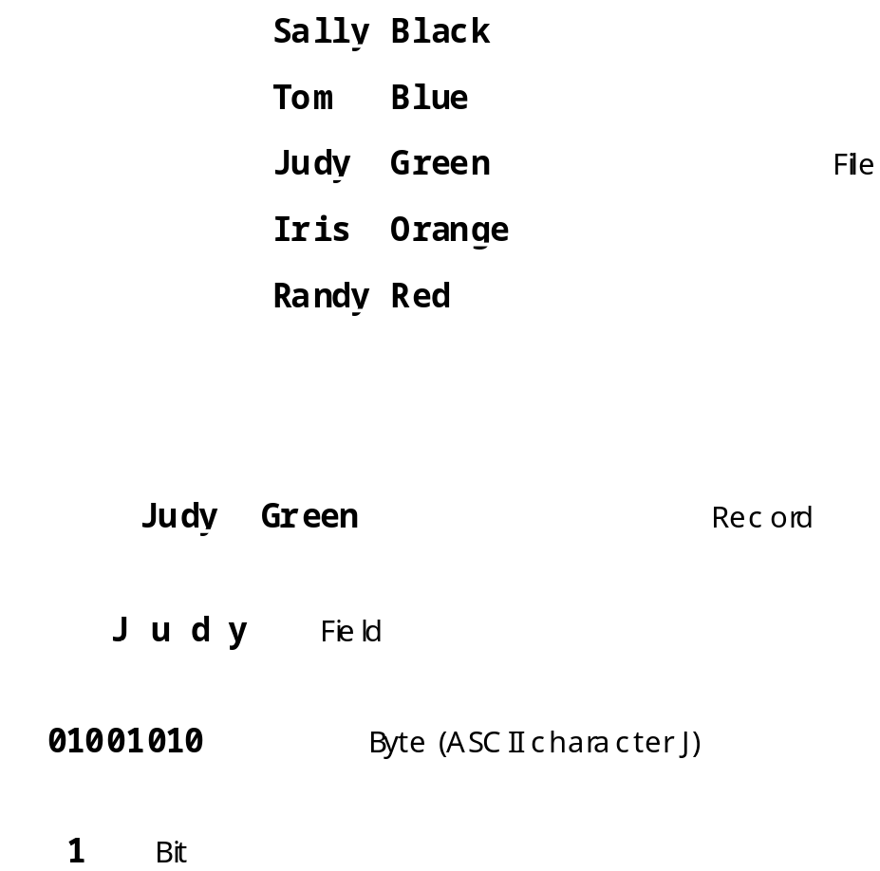
Fig. 16.1 The data hierarchy.

Slide 6
16.3 Files and Streams
Java views a file as a stream of bytes (Fig. 16.2)
  File ends with end-of-file marker or a specific byte number
  File as a stream of bytes associated with an object
    Java also associates streams with devices
      System.in, System.out, and System.err
      Streams can be redirected
File processing with classes in package java.io
  FileInputStream for byte-based input from a file
  FileOutputStream for byte-based output to a file
  FileReader for character-based input from a file
  FileWriter for character-based output to a file
  Fig 16.3 summarizes inheritance relationships in java.io

Slide 7
16.3 Files and Streams
Buffering
  Improves performance of I/O
  Copies each output to a region of memory called a buffer
  Entire buffer output to disk at once
    One long disk access takes less time than many smaller ones
  BufferedInputStream buffers file output
  BufferedOutputStream buffers file input

Slide 8
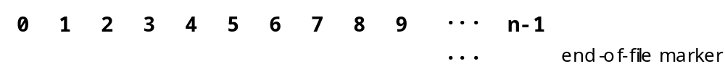
Fig. 16.2 Java’s view of a file of n bytes.

Slide 9
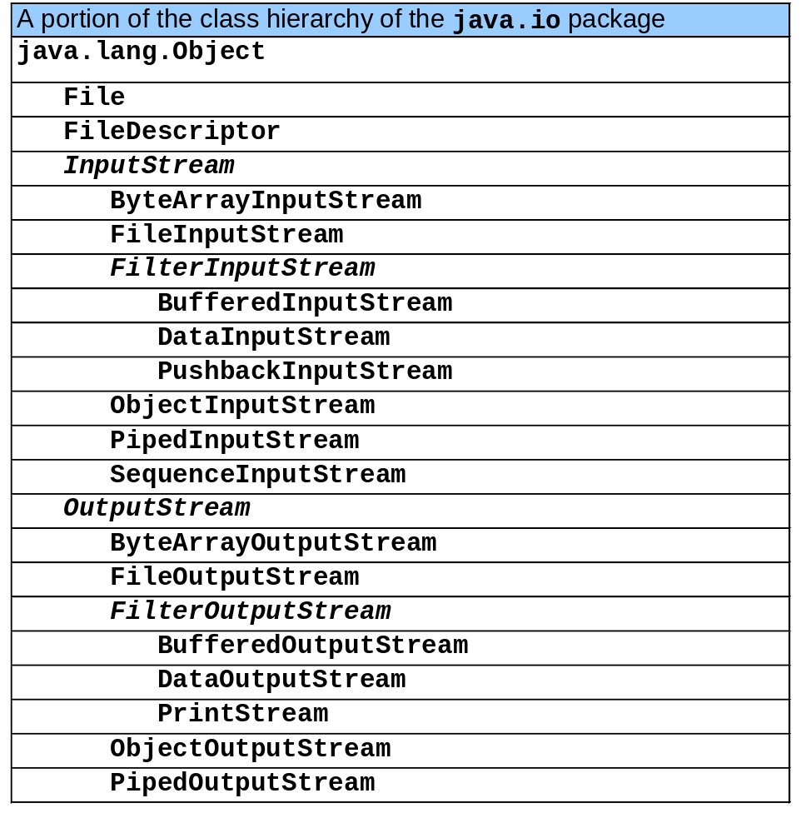
Fig. 16.3 A portion of the class hierarchy of the java.io package.

Slide 10
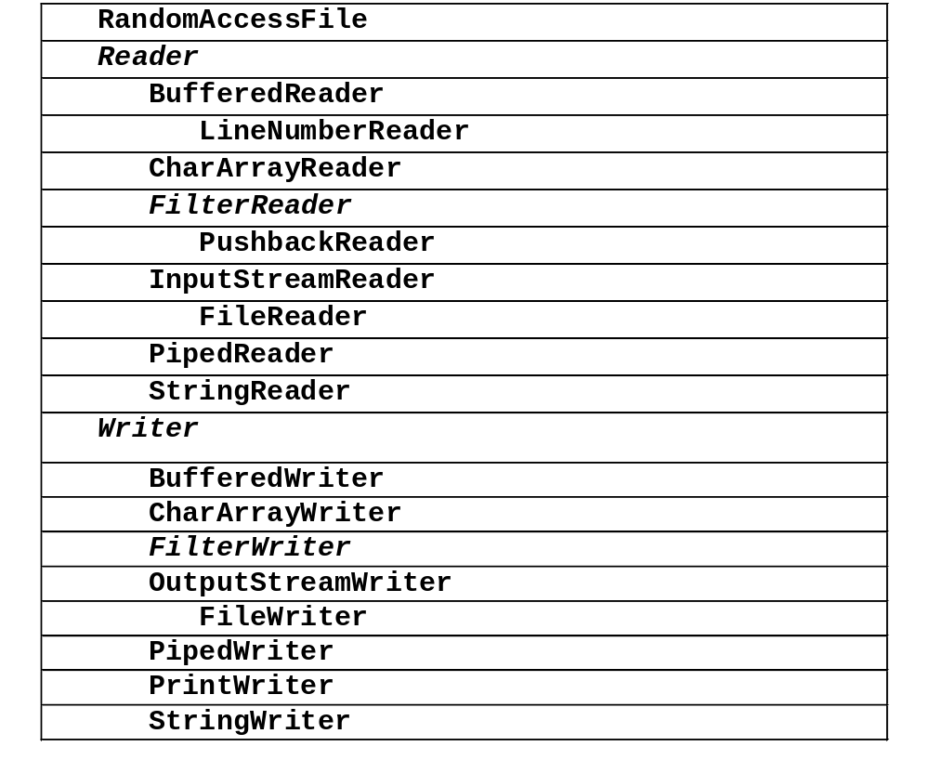
Fig. 16.3 A portion of the class hierarchy of the java.io package (cont.).

Slide 11
16.4 Creating a Sequential-Access File
Java Files
  Java imposes no structure on a file
  Programmer structures file according to application
  Following program uses simple record structure

Slide 12
Fig. 16.4 BankUI contains a reusable GUI for several programs.
Line 11
Lines 19-22
1 // Fig. 16.4: BankUI.java
2 // A reusable GUI for the examples in this chapter.
3 package com.deitel.jhtp4.ch16;
4
5 // Java core packages
6 import java.awt.*;
7
8 // Java extension packages
9 import javax.swing.*;
10
11 public class BankUI extends JPanel {
12
13 // label text for GUI
14 protected final static String names[] = { "Account number",
15 "First name", "Last name", "Balance",
16 "Transaction Amount" };
17
18 // GUI components; protected for future subclass access
19 protected JLabel labels[];
20 protected JTextField fields[];
21 protected JButton doTask1, doTask2;
22 protected JPanel innerPanelCenter, innerPanelSouth;
23
24 // number of text fields in GUI
25 protected int size;
26
27 // constants representing text fields in GUI
28 public static final int ACCOUNT = 0, FIRSTNAME = 1,
29 LASTNAME = 2, BALANCE = 3, TRANSACTION = 4;
Bank GUI for all examples in this chapter
JButtons, JLabels and JTextFields for the GUI

Slide 13
Fig. 16.4 BankUI contains a reusable GUI for several programs (Part 2).
Lines 34-75
30
31 // Set up GUI. Constructor argument of 4 creates four rows
32 // of GUI components. Constructor argument of 5 (used in a
33 // later program) creates five rows of GUI components.
34 public BankUI( int mySize )
35 {
36 size = mySize;
37 labels = new JLabel[ size ];
38 fields = new JTextField[ size ];
39
40 // create labels
41 for ( int count = 0; count < labels.length; count++ )
42 labels[ count ] = new JLabel( names[ count ] );
43
44 // create text fields
45 for ( int count = 0; count < fields.length; count++ )
46 fields[ count ] = new JTextField();
47
48 // create panel to lay out labels and fields
49 innerPanelCenter = new JPanel();
50 innerPanelCenter.setLayout( new GridLayout( size, 2 ) );
51
52 // attach labels and fields to innerPanelCenter
53 for ( int count = 0; count < size; count++ ) {
54 innerPanelCenter.add( labels[ count ] );
55 innerPanelCenter.add( fields[ count ] );
56 }
57
58 // create generic buttons; no labels or event handlers
59 doTask1 = new JButton();
60 doTask2 = new JButton();
BankUI constructor initializes GUI and sets number of JLabels and JTextFields

Slide 14
Fig. 16.4 BankUI contains a reusable GUI for several programs (Part 3).
Lines 78-81
Lines 84-87
Lines 90-93
61
62 // create panel to lay out buttons and attach buttons
63 innerPanelSouth = new JPanel();
64 innerPanelSouth.add( doTask1 );
65 innerPanelSouth.add( doTask2 );
66
67 // set layout of this container and attach panels to it
68 setLayout( new BorderLayout() );
69 add( innerPanelCenter, BorderLayout.CENTER );
70 add( innerPanelSouth, BorderLayout.SOUTH );
71
72 // validate layout
73 validate();
74
75 } // end constructor
76
77 // return reference to generic task button doTask1
78 public JButton getDoTask1Button()
79 {
80 return doTask1;
81 }
82
83 // return reference to generic task button doTask2
84 public JButton getDoTask2Button()
85 {
86 return doTask2;
87 }
88
89 // return reference to fields array of JTextFields
90 public JTextField[] getFields()
91 {
92 return fields;
93 }
Method getDoTask1Button returns reference to button doTask1
Method getDoTask2Button returns reference to button doTask2
Method getFields returns reference to array of JTextFields

Slide 15
Fig. 16.4 BankUI contains a reusable GUI for several programs (Part 4).
Lines 96-100
Lines 104-113
Lines 116-124
94
95 // clear content of text fields
96 public void clearFields()
97 {
98 for ( int count = 0; count < size; count++ )
99 fields[ count ].setText( "" );
100 }
101
102 // set text field values; throw IllegalArgumentException if
103 // incorrect number of Strings in argument
104 public void setFieldValues( String strings[] )
105 throws IllegalArgumentException
106 {
107 if ( strings.length != size )
108 throw new IllegalArgumentException( "There must be " +
109 size + " Strings in the array" );
110
111 for ( int count = 0; count < size; count++ )
112 fields[ count ].setText( strings[ count ] );
113 }
114
115 // get array of Strings with current text field contents
116 public String[] getFieldValues()
117 {
118 String values[] = new String[ size ];
119
120 for ( int count = 0; count < size; count++ )
121 values[ count ] = fields[ count ].getText();
122
123 return values;
124 }
125
126 } // end class BankUI
Method clearFields deletes all text in the JTextFields
Method setFieldValues sets the values of the JTextFields
Method getFieldValues returns the values of the JTextFields

Slide 16
Fig. 16.5 Class AccountRecord maintains information for one account.
Line 8
Lines 9-12
1 // Fig. 16.5: AccountRecord.java
2 // A class that represents one record of information.
3 package com.deitel.jhtp4.ch16;
4
5 // Java core packages
6 import java.io.Serializable;
7
8 public class AccountRecord implements Serializable {
9 private int account;
10 private String firstName;
11 private String lastName;
12 private double balance;
13
14 // no-argument constructor calls other constructor with
15 // default values
16 public AccountRecord()
17 {
18 this( 0, "", "", 0.0 );
19 }
20
21 // initialize a record
22 public AccountRecord( int acct, String first,
23 String last, double bal )
24 {
25 setAccount( acct );
26 setFirstName( first );
27 setLastName( last );
28 setBalance( bal );
29 }
30
31 // set account number
32 public void setAccount( int acct )
33 {
34 account = acct;
35 }
Implements interface Serializable so AccountRecords can be used with ObjectInputStreams and ObjectOutputStreams
Fields account, firstName, lastName and balance hold record information

Slide 17
Fig. 16.5 Class AccountRecord maintains information for one account (Part 2).
36
37 // get account number
38 public int getAccount()
39 {
40 return account;
41 }
42
43 // set first name
44 public void setFirstName( String first )
45 {
46 firstName = first;
47 }
48
49 // get first name
50 public String getFirstName()
51 {
52 return firstName;
53 }
54
55 // set last name
56 public void setLastName( String last )
57 {
58 lastName = last;
59 }
60
61 // get last name
62 public String getLastName()
63 {
64 return lastName;
65 }

Slide 18
Fig. 16.5 Class AccountRecord maintains information for one account (Part 3).
66
67 // set balance
68 public void setBalance( double bal )
69 {
70 balance = bal;
71 }
72
73 // get balance
74 public double getBalance()
75 {
76 return balance;
77 }
78
79 } // end class AccountRecord

Slide 19
Fig. 16.6 Creating a sequential file.
1 // Fig. 16.6: CreateSequentialFile.java
2 // Demonstrating object output with class ObjectOutputStream.
3 // The objects are written sequentially to a file.
4
5 // Java core packages
6 import java.io.*;
7 import java.awt.*;
8 import java.awt.event.*;
9
10 // Java extension packages
11 import javax.swing.*;
12
13 // Deitel packages
14 import com.deitel.jhtp4.ch16.BankUI;
15 import com.deitel.jhtp4.ch16.AccountRecord;
16
17 public class CreateSequentialFile extends JFrame {
18 private ObjectOutputStream output;
19 private BankUI userInterface;
20 private JButton enterButton, openButton;
21
22 // set up GUI
23 public CreateSequentialFile()
24 {
25 super( "Creating a Sequential File of Objects" );
26
27 // create instance of reusable user interface
28 userInterface = new BankUI( 4 ); // four textfields
29 getContentPane().add(
30 userInterface, BorderLayout.CENTER );
31
32 // get reference to generic task button doTask1 in BankUI
33 // and configure button for use in this program
34 openButton = userInterface.getDoTask1Button();
35 openButton.setText( "Save into File ..." );

Slide 20
Fig. 16.6 Creating a sequential file (Part 2).
Lines 66-69
36
37 // register listener to call openFile when button pressed
38 openButton.addActionListener(
39
40 // anonymous inner class to handle openButton event
41 new ActionListener() {
42
43 // call openFile when button pressed
44 public void actionPerformed( ActionEvent event )
45 {
46 openFile();
47 }
48
49 } // end anonymous inner class
50
51 ); // end call to addActionListener
52
53 // get reference to generic task button doTask2 in BankUI
54 // and configure button for use in this program
55 enterButton = userInterface.getDoTask2Button();
56 enterButton.setText( "Enter" );
57 enterButton.setEnabled( false ); // disable button
58
59 // register listener to call addRecord when button pressed
60 enterButton.addActionListener(
61
62 // anonymous inner class to handle enterButton event
63 new ActionListener() {
64
65 // call addRecord when button pressed
66 public void actionPerformed( ActionEvent event )
67 {
68 addRecord();
69 }
Method actionPerformed calls method addRecord

Slide 21
Fig. 16.6 Creating a sequential file (Part 3).
Lines 82-88
70
71 } // end anonymous inner class
72
73 ); // end call to addActionListener
74
75 // register window listener to handle window closing event
76 addWindowListener(
77
78 // anonymous inner class to handle windowClosing event
79 new WindowAdapter() {
80
81 // add current record in GUI to file, then close file
82 public void windowClosing( WindowEvent event )
83 {
84 if ( output != null )
85 addRecord();
86
87 closeFile();
88 }
89
90 } // end anonymous inner class
91
92 ); // end call to addWindowListener
93
94 setSize( 300, 200 );
95 show();
96
97 } // end CreateSequentialFile constructor
Add current record to file and close file when closing window

Slide 22
Fig. 16.6 Creating a sequential file (Part 4).
Line 103
Lines 104-105
Line 107
Line 110
Line 114
Lines 127-128
98
99 // allow user to specify file name
100 private void openFile()
101 {
102 // display file dialog, so user can choose file to open
103 JFileChooser fileChooser = new JFileChooser();
104 fileChooser.setFileSelectionMode(
105 JFileChooser.FILES_ONLY );
106
107 int result = fileChooser.showSaveDialog( this );
108
109 // if user clicked Cancel button on dialog, return
110 if ( result == JFileChooser.CANCEL_OPTION )
111 return;
112
113 // get selected file
114 File fileName = fileChooser.getSelectedFile();
115
116 // display error if invalid
117 if ( fileName == null ||
118 fileName.getName().equals( "" ) )
119 JOptionPane.showMessageDialog( this,
120 "Invalid File Name", "Invalid File Name",
121 JOptionPane.ERROR_MESSAGE );
122
123 else {
124
125 // open file
126 try {
127 output = new ObjectOutputStream(
128 new FileOutputStream( fileName ) );
129
130 openButton.setEnabled( false );
131 enterButton.setEnabled( true );
132 }
Instantiate a JFileChooser and assign it to fileChooser
Method call setFileSelectionMode with constant FILES_ONLY indicates only files can be selected
Method showSaveDialog causes the JFileChooser titled Save to appear
Return if user clicked Cancel button on dialog
Retrieve selected file
Open selected file

Slide 23
Fig. 16.6 Creating a sequential file (Part 5).
Lines 145-161
133
134 // process exceptions from opening file
135 catch ( IOException ioException ) {
136 JOptionPane.showMessageDialog( this,
137 "Error Opening File", "Error",
138 JOptionPane.ERROR_MESSAGE );
139 }
140 }
141
142 } // end method openFile
143
144 // close file and terminate application
145 private void closeFile()
146 {
147 // close file
148 try {
149 output.close();
150
151 System.exit( 0 );
152 }
153
154 // process exceptions from closing file
155 catch( IOException ioException ) {
156 JOptionPane.showMessageDialog( this,
157 "Error closing file", "Error",
158 JOptionPane.ERROR_MESSAGE );
159 System.exit( 1 );
160 }
161 }
Method closeFile closes the current file

Slide 24
Fig. 16.6 Creating a sequential file (Part 6).
Lines 164-211
Line 188
Line 189
162
163 // add record to file
164 public void addRecord()
165 {
166 int accountNumber = 0;
167 AccountRecord record;
168 String fieldValues[] = userInterface.getFieldValues();
169
170 // if account field value is not empty
171 if ( ! fieldValues[ BankUI.ACCOUNT ].equals( "" ) ) {
172
173 // output values to file
174 try {
175 accountNumber = Integer.parseInt(
176 fieldValues[ BankUI.ACCOUNT ] );
177
178 if ( accountNumber > 0 ) {
179
180 // create new record
181 record = new AccountRecord( accountNumber,
182 fieldValues[ BankUI.FIRSTNAME ],
183 fieldValues[ BankUI.LASTNAME ],
184 Double.parseDouble(
185 fieldValues[ BankUI.BALANCE ] ) );
186
187 // output record and flush buffer
188 output.writeObject( record );
189 output.flush();
190 }
191
192 // clear textfields
193 userInterface.clearFields();
194 }
195
Method addRecord performs the write operation
Method writeObject writes the record object to file
Method flush ensures all data in memory written to file

Slide 25
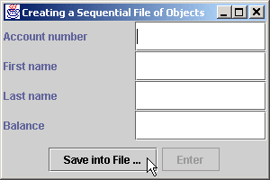
Fig. 16.6 Creating a sequential file (Part 7).
196 // process invalid account number or balance format
197 catch ( NumberFormatException formatException ) {
198 JOptionPane.showMessageDialog( this,
199 "Bad account number or balance",
200 "Invalid Number Format",
201 JOptionPane.ERROR_MESSAGE );
202 }
203
204 // process exceptions from file output
205 catch ( IOException ioException ) {
206 closeFile();
207 }
208
209 } // end if
210
211 } // end method addRecord
212
213 // execute application; CreateSequentialFile constructor
214 // displays window
215 public static void main( String args[] )
216 {
217 new CreateSequentialFile();
218 }
219
220 } // end class CreateSequentialFile

Slide 26
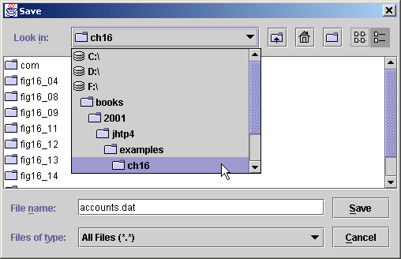
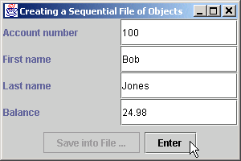
Fig. 16.6 Creating a sequential file (Part 8).
Select location for file here
Click Save to submit new file name to program
Files and directories are displayed here
BankUI graphical user interface

Slide 27
16.5 Reading Data from a Sequential-Access File
Data stored in files
  Retrieved for processing when needed
  Accessing a sequential file
    Data must be read in same format it was written

Slide 28
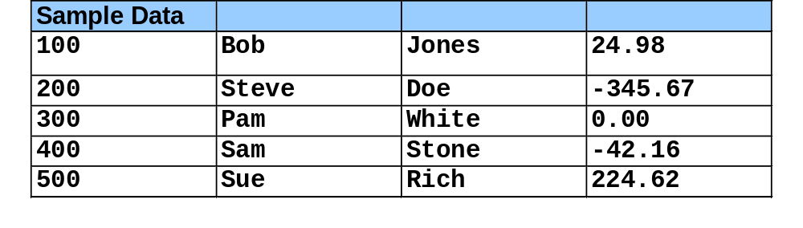
Fig. 16.7 Sample data for the program of Fig. 16.6.

Slide 29
Fig. 16.8 Reading a sequential file.
1 // Fig. 16.8: ReadSequentialFile.java
2 // This program reads a file of objects sequentially
3 // and displays each record.
4
5 // Java core packages
6 import java.io.*;
7 import java.awt.*;
8 import java.awt.event.*;
9
10 // Java extension packages
11 import javax.swing.*;
12
13 // Deitel packages
14 import com.deitel.jhtp4.ch16.*;
15
16 public class ReadSequentialFile extends JFrame {
17 private ObjectInputStream input;
18 private BankUI userInterface;
19 private JButton nextButton, openButton;
20
21 // Constructor -- initialize the Frame
22 public ReadSequentialFile()
23 {
24 super( "Reading a Sequential File of Objects" );
25
26 // create instance of reusable user interface
27 userInterface = new BankUI( 4 ); // four textfields
28 getContentPane().add(
29 userInterface, BorderLayout.CENTER );
30
31 // get reference to generic task button doTask1 from BankUI
32 openButton = userInterface.getDoTask1Button();
33 openButton.setText( "Open File" );
34

Slide 30
Fig. 16.8 Reading a sequential file (Part 2).
35 // register listener to call openFile when button pressed
36 openButton.addActionListener(
37
38 // anonymous inner class to handle openButton event
39 new ActionListener() {
40
41 // close file and terminate application
42 public void actionPerformed( ActionEvent event )
43 {
44 openFile();
45 }
46
47 } // end anonymous inner class
48
49 ); // end call to addActionListener
50
51 // register window listener for window closing event
52 addWindowListener(
53
54 // anonymous inner class to handle windowClosing event
55 new WindowAdapter() {
56
57 // close file and terminate application
58 public void windowClosing( WindowEvent event )
59 {
60 if ( input != null )
61 closeFile();
62
63 System.exit( 0 );
64 }
65
66 } // end anonymous inner class
67
68 ); // end call to addWindowListener
69

Slide 31
Fig. 16.8 Reading a sequential file (Part 3).
Line 84
70 // get reference to generic task button doTask2 from BankUI
71 nextButton = userInterface.getDoTask2Button();
72 nextButton.setText( "Next Record" );
73 nextButton.setEnabled( false );
74
75 // register listener to call readRecord when button pressed
76 nextButton.addActionListener(
77
78 // anonymous inner class to handle nextRecord event
79 new ActionListener() {
80
81 // call readRecord when user clicks nextRecord
82 public void actionPerformed( ActionEvent event )
83 {
84 readRecord();
85 }
86
87 } // end anonymous inner class
88
89 ); // end call to addActionListener
90
91 pack();
92 setSize( 300, 200 );
93 show();
94
95 } // end ReadSequentialFile constructor
96
97 // enable user to select file to open
98 private void openFile()
99 {
100 // display file dialog so user can select file to open
101 JFileChooser fileChooser = new JFileChooser();
102 fileChooser.setFileSelectionMode(
103 JFileChooser.FILES_ONLY );
Method actionPerformed calls method readRecord

Slide 32
Fig. 16.8 Reading a sequential file (Part 4).
Line 105
Lines 125-126
Method showOpenDialog displays the Open file dialog
104
105 int result = fileChooser.showOpenDialog( this );
106
107 // if user clicked Cancel button on dialog, return
108 if ( result == JFileChooser.CANCEL_OPTION )
109 return;
110
111 // obtain selected file
112 File fileName = fileChooser.getSelectedFile();
113
114 // display error if file name invalid
115 if ( fileName == null ||
116 fileName.getName().equals( "" ) )
117 JOptionPane.showMessageDialog( this,
118 "Invalid File Name", "Invalid File Name",
119 JOptionPane.ERROR_MESSAGE );
120
121 else {
122
123 // open file
124 try {
125 input = new ObjectInputStream(
126 new FileInputStream( fileName ) );
127
128 openButton.setEnabled( false );
129 nextButton.setEnabled( true );
130 }
131
132 // process exceptions opening file
133 catch ( IOException ioException ) {
134 JOptionPane.showMessageDialog( this,
135 "Error Opening File", "Error",
136 JOptionPane.ERROR_MESSAGE );
137 }
ObjectInputStream object created and assigned to input

Slide 33
Fig. 16.8 Reading a sequential file (Part 5).
Lines 144-187
Line 150
138
139 } // end else
140
141 } // end method openFile
142
143 // read record from file
144 public void readRecord()
145 {
146 AccountRecord record;
147
148 // input the values from the file
149 try {
150 record = ( AccountRecord ) input.readObject();
151
152 // create array of Strings to display in GUI
153 String values[] = {
154 String.valueOf( record.getAccount() ),
155 record.getFirstName(),
156 record.getLastName(),
157 String.valueOf( record.getBalance() ) };
158
159 // display record contents
160 userInterface.setFieldValues( values );
161 }
162
163 // display message when end-of-file reached
164 catch ( EOFException endOfFileException ) {
165 nextButton.setEnabled( false );
166
167 JOptionPane.showMessageDialog( this,
168 "No more records in file",
169 "End of File", JOptionPane.ERROR_MESSAGE );
170 }
Method readRecord reads a record from the file
Method readObject reads an Object from the ObjectInputStream

Slide 34
Fig. 16.8 Reading a sequential file (Part 6).
171
172 // display error message if cannot read object
173 // because class not found
174 catch ( ClassNotFoundException classNotFoundException ) {
175 JOptionPane.showMessageDialog( this,
176 "Unable to create object",
177 "Class Not Found", JOptionPane.ERROR_MESSAGE );
178 }
179
180 // display error message if cannot read
181 // due to problem with file
182 catch ( IOException ioException ) {
183 JOptionPane.showMessageDialog( this,
184 "Error during read from file",
185 "Read Error", JOptionPane.ERROR_MESSAGE );
186 }
187 }
188
189 // close file and terminate application
190 private void closeFile()
191 {
192 // close file and exit
193 try {
194 input.close();
195 System.exit( 0 );
196 }
197
198 // process exception while closing file
199 catch ( IOException ioException ) {
200 JOptionPane.showMessageDialog( this,
201 "Error closing file",
202 "Error", JOptionPane.ERROR_MESSAGE );

Slide 35
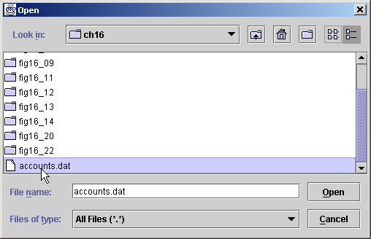
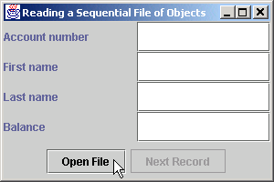
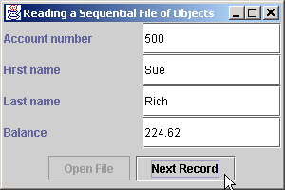
Fig. 16.8 Reading a sequential file (Part 7).
203
204 System.exit( 1 );
205 }
206 }
207
208 // execute application; ReadSequentialFile constructor
209 // displays window
210 public static void main( String args[] )
211 {
212 new ReadSequentialFile();
213 }
214
215 } // end class ReadSequentialFile

Slide 36
Fig. 16.9 Credit inquiry program.
Line 20
1 // Fig. 16.9: CreditInquiry.java
2 // This program reads a file sequentially and displays the
3 // contents in a text area based on the type of account the
4 // user requests (credit balance, debit balance or
5 // zero balance).
6
7 // Java core packages
8 import java.io.*;
9 import java.awt.*;
10 import java.awt.event.*;
11 import java.text.DecimalFormat;
12
13 // Java extension packages
14 import javax.swing.*;
15
16 // Deitel packages
17 import com.deitel.jhtp4.ch16.AccountRecord;
18
19 public class CreditInquiry extends JFrame {
20 private JTextArea recordDisplayArea;
21 private JButton openButton,
22 creditButton, debitButton, zeroButton;
23 private JPanel buttonPanel;
24
25 private ObjectInputStream input;
26 private FileInputStream fileInput;
27 private File fileName;
28 private String accountType;
29
30 // set up GUI
31 public CreditInquiry()
32 {
33 super( "Credit Inquiry Program" );
34
JTextArea recordDisplayArea shows record information

Slide 37
Fig. 16.9 Credit inquiry program (Part 2).
35 Container container = getContentPane();
36
37 // set up panel for buttons
38 buttonPanel = new JPanel();
39
40 // create and configure button to open file
41 openButton = new JButton( "Open File" );
42 buttonPanel.add( openButton );
43
44 // register openButton listener
45 openButton.addActionListener(
46
47 // anonymous inner class to handle openButton event
48 new ActionListener() {
49
50 // open file for processing
51 public void actionPerformed( ActionEvent event )
52 {
53 openFile( true );
54 }
55
56 } // end anonymous inner class
57
58 ); // end call to addActionListener
59
60 // create and configure button to get
61 // accounts with credit balances
62 creditButton = new JButton( "Credit balances" );
63 buttonPanel.add( creditButton );
64 creditButton.addActionListener( new ButtonHandler() );
65
66 // create and configure button to get
67 // accounts with debit balances
68 debitButton = new JButton( "Debit balances" );
69 buttonPanel.add( debitButton );
70 debitButton.addActionListener( new ButtonHandler() );

Slide 38
Fig. 16.9 Credit inquiry program (Part 3).
71
72 // create and configure button to get
73 // accounts with credit balances
74 zeroButton = new JButton( "Zero balances" );
75 buttonPanel.add( zeroButton );
76 zeroButton.addActionListener( new ButtonHandler() );
77
78 // set up display area
79 recordDisplayArea = new JTextArea();
80 JScrollPane scroller =
81 new JScrollPane( recordDisplayArea );
82
83 // attach components to content pane
84 container.add( scroller, BorderLayout.CENTER );
85 container.add( buttonPanel, BorderLayout.SOUTH );
86
87 // disable creditButton, debitButton and zeroButton
88 creditButton.setEnabled( false );
89 debitButton.setEnabled( false );
90 zeroButton.setEnabled( false );
91
92 // register window listener
93 addWindowListener(
94
95 // anonymous inner class for windowClosing event
96 new WindowAdapter() {
97
98 // close file and terminate program
99 public void windowClosing( WindowEvent event )
100 {
101 closeFile();
102 System.exit( 0 );
103 }
104
105 } // end anonymous inner class

Slide 39
Fig. 16.9 Credit inquiry program (Part 4).
106
107 ); // end call to addWindowListener
108
109 // pack components and display window
110 pack();
111 setSize( 600, 250 );
112 show();
113
114 } // end CreditInquiry constructor
115
116 // enable user to choose file to open first time;
117 // otherwise, reopen chosen file
118 private void openFile( boolean firstTime )
119 {
120 if ( firstTime ) {
121
122 // display dialog, so user can choose file
123 JFileChooser fileChooser = new JFileChooser();
124 fileChooser.setFileSelectionMode(
125 JFileChooser.FILES_ONLY );
126
127 int result = fileChooser.showOpenDialog( this );
128
129 // if user clicked Cancel button on dialog, return
130 if ( result == JFileChooser.CANCEL_OPTION )
131 return;
132
133 // obtain selected file
134 fileName = fileChooser.getSelectedFile();
135 }
136

Slide 40
Fig. 16.9 Credit inquiry program (Part 5).
137 // display error if file name invalid
138 if ( fileName == null ||
139 fileName.getName().equals( "" ) )
140 JOptionPane.showMessageDialog( this,
141 "Invalid File Name", "Invalid File Name",
142 JOptionPane.ERROR_MESSAGE );
143
144 else {
145
146 // open file
147 try {
148
149 // close file from previous operation
150 if ( input != null )
151 input.close();
152
153 fileInput = new FileInputStream( fileName );
154 input = new ObjectInputStream( fileInput );
155 openButton.setEnabled( false );
156 creditButton.setEnabled( true );
157 debitButton.setEnabled( true );
158 zeroButton.setEnabled( true );
159 }
160
161 // catch problems manipulating file
162 catch ( IOException ioException ) {
163 JOptionPane.showMessageDialog( this,
164 "File does not exist", "Invalid File Name",
165 JOptionPane.ERROR_MESSAGE );
166 }
167 }
168
169 } // end method openFile
170

Slide 41
Fig. 16.9 Credit inquiry program (Part 6).
Lines 191-238
171 // close file before application terminates
172 private void closeFile()
173 {
174 // close file
175 try {
176 input.close();
177 }
178
179 // process exception from closing file
180 catch ( IOException ioException ) {
181 JOptionPane.showMessageDialog( this,
182 "Error closing file",
183 "Error", JOptionPane.ERROR_MESSAGE );
184
185 System.exit( 1 );
186 }
187 }
188
189 // read records from file and display only records of
190 // appropriate type
191 private void readRecords()
192 {
193 AccountRecord record;
194 DecimalFormat twoDigits = new DecimalFormat( "0.00" );
195 openFile( false );
196
197 // read records
198 try {
199 recordDisplayArea.setText( "The accounts are:\n" );
200
201 // input the values from the file
202 while ( true ) {
203
Method readRecords reads records from file and displays only records of appropriate type

Slide 42
Fig. 16.9 Credit inquiry program (Part 7).
Line 208-213
Line 219
204 // read one AccountRecord
205 record = ( AccountRecord ) input.readObject();
206
207 // if proper acount type, display record
208 if ( shouldDisplay( record.getBalance() ) )
209 recordDisplayArea.append( record.getAccount() +
210 "\t" + record.getFirstName() + "\t" +
211 record.getLastName() + "\t" +
212 twoDigits.format( record.getBalance() ) +
213 "\n" );
214 }
215 }
216
217 // close file when end-of-file reached
218 catch ( EOFException eofException ) {
219 closeFile();
220 }
221
222 // display error if cannot read object
223 // because class not found
224 catch ( ClassNotFoundException classNotFound ) {
225 JOptionPane.showMessageDialog( this,
226 "Unable to create object",
227 "Class Not Found", JOptionPane.ERROR_MESSAGE );
228 }
229
230 // display error if cannot read
231 // because problem with file
232 catch ( IOException ioException ) {
233 JOptionPane.showMessageDialog( this,
234 "Error reading from file",
235 "Error", JOptionPane.ERROR_MESSAGE );
236 }
237
238 } // end method readRecords
If proper account type, append record to JTextArea
Close file when end-of-file reached

Slide 43
Fig. 16.9 Credit inquiry program (Part 8).
Lines 241-259
239
240 // uses record ty to determine if a record should be displayed
241 private boolean shouldDisplay( double balance )
242 {
243 if ( accountType.equals( "Credit balances" ) &&
244 balance < 0 )
245
246 return true;
247
248 else if ( accountType.equals( "Debit balances" ) &&
249 balance > 0 )
250
251 return true;
252
253 else if ( accountType.equals( "Zero balances" ) &&
254 balance == 0 )
255
256 return true;
257
258 return false;
259 }
260
261 // execute application
262 public static void main( String args[] )
263 {
264 new CreditInquiry();
265 }
266
267 // private inner class for creditButton, debitButton and
268 // zeroButton event handling
269 private class ButtonHandler implements ActionListener {
270
Method shouldDisplay determines if a record should be displayed

Slide 44
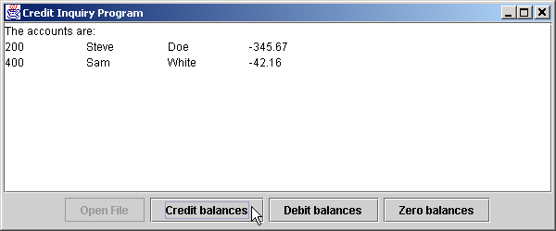
Fig. 16.9 Credit inquiry program (Part 9).
Line 274-275
271 // read records from file
272 public void actionPerformed( ActionEvent event )
273 {
274 accountType = event.getActionCommand();
275 readRecords();
276 }
277
278 } // end class ButtonHandler
279
280 } // end class CreditInquiry
Clicking a button sets accountType to the clicked button’s text and invokes method readRecords

Slide 45
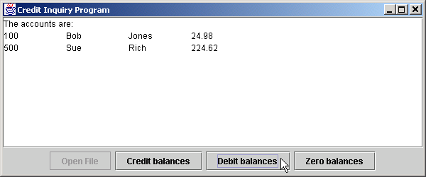
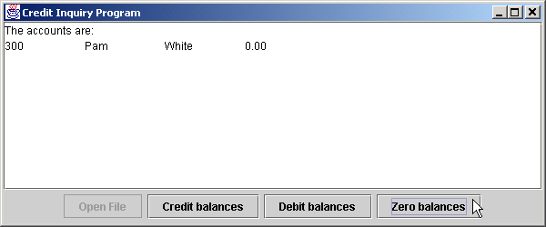
Fig. 16.9 Credit inquiry program (Part 10).

Slide 46
16.6 Updating Sequential-Access File
Difficult to update a sequential-access file
  Entire file must be rewritten to change one field
  Only acceptable if many records being updated at once

Slide 47
16.7 Random-Access File
“Instant-access” applications
  Record must be located immediately
  Transaction-processing systems require rapid access
Random-access files
  Access individual records directly and quickly
  Use fixed length for every record
    Easy to calculate record locations
  Insert records without destroying other data in file
  Fig. 16.10 shows random-access file

Slide 48
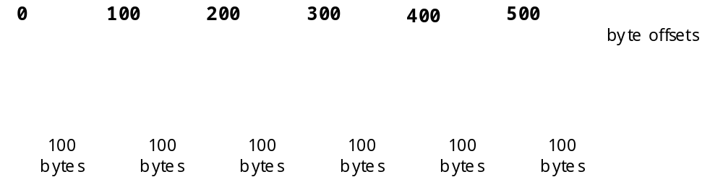
Fig. 16.10 Java’s view of a random-access file.

Slide 49
16.8 Creating a Random-Access File
RandomAccessFile objects
  Like DataInputStream and DataOutputstream
  Reads or writes data in spot specified by file-position pointer
    Manipulates all data as primitive types
    Normally writes one object at a time to file

Slide 50
Fig. 16.11 RandomAccess-AccountRecord class used in the random-access file programs.
Line 8
Lines 25-31
Line 27
Line 30
1 // Fig. 16.11: RandomAccessAccountRecord.java
2 // Subclass of AccountRecord for random access file programs.
3 package com.deitel.jhtp4.ch16;
4
5 // Java core packages
6 import java.io.*;
7
8 public class RandomAccessAccountRecord extends AccountRecord {
9
10 // no-argument constructor calls other constructor
11 // with default values
12 public RandomAccessAccountRecord()
13 {
14 this( 0, "", "", 0.0 );
15 }
16
17 // initialize a RandomAccessAccountRecord
18 public RandomAccessAccountRecord( int account,
19 String firstName, String lastName, double balance )
20 {
21 super( account, firstName, lastName, balance );
22 }
23
24 // read a record from specified RandomAccessFile
25 public void read( RandomAccessFile file ) throws IOException
26 {
27 setAccount( file.readInt() );
28 setFirstName( padName( file ) );
29 setLastName( padName( file ) );
30 setBalance( file.readDouble() );
31 }
32
Class inherits all of AccountRecord’s methods and instance variables
Method read reads one record from the RandomAccessFile object passed as an argument
Method readInt reads variable account
Method readDouble reads variable balance

Slide 51
Fig. 16.11 RandomAccess-AccountRecord class used in the random-access file programs (Part 2).
Lines 34-45
Line 44
Lines 48-54
Lines 57-69
Method padName reads fifteen characters and from the file and returns a String
33 // ensure that name is proper length
34 private String padName( RandomAccessFile file )
35 throws IOException
36 {
37 char name[] = new char[ 15 ], temp;
38
39 for ( int count = 0; count < name.length; count++ ) {
40 temp = file.readChar();
41 name[ count ] = temp;
42 }
43
44 return new String( name ).replace( '\0', ' ' );
45 }
46
47 // write a record to specified RandomAccessFile
48 public void write( RandomAccessFile file ) throws IOException
49 {
50 file.writeInt( getAccount() );
51 writeName( file, getFirstName() );
52 writeName( file, getLastName() );
53 file.writeDouble( getBalance() );
54 }
55
56 // write a name to file; maximum of 15 characters
57 private void writeName( RandomAccessFile file, String name )
58 throws IOException
59 {
60 StringBuffer buffer = null;
61
62 if ( name != null )
63 buffer = new StringBuffer( name );
64 else
65 buffer = new StringBuffer( 15 );
66
Replace null bytes with spaces
Method write outputs one record to the RandomAccessFile passed as an argument
Method writeName performs write operation for first and last name

Slide 52
Fig. 16.11 RandomAccess-AccountRecord class used in the random-access file programs (Part 3).
67 buffer.setLength( 15 );
68 file.writeChars( buffer.toString() );
69 }
70
71 // NOTE: This method contains a hard coded value for the
72 // size of a record of information.
73 public static int size()
74 {
75 return 72;
76 }
77
78 } // end class RandomAccessAccountRecord

Slide 53
Fig. 16.12 Creating a random-access file sequentially.
1 // Fig. 16.12: CreateRandomFile.java
2 // This program creates a random access file sequentially
3 // by writing 100 empty records to disk.
4
5 // Java core packages
6 import java.io.*;
7
8 // Java extension packages
9 import javax.swing.*;
10
11 // Deitel packages
12 import com.deitel.jhtp4.ch16.RandomAccessAccountRecord;
13
14 public class CreateRandomFile {
15
16 // enable user to select file to open
17 private void createFile()
18 {
19 // display dialog so user can choose file
20 JFileChooser fileChooser = new JFileChooser();
21 fileChooser.setFileSelectionMode(
22 JFileChooser.FILES_ONLY );
23
24 int result = fileChooser.showSaveDialog( null );
25
26 // if user clicked Cancel button on dialog, return
27 if ( result == JFileChooser.CANCEL_OPTION )
28 return;
29
30 // obtain selected file
31 File fileName = fileChooser.getSelectedFile();
32

Slide 54
Fig. 16.12 Creating a random-access file sequentially (Part 2).
Lines 44-45
Lines 51-52
33 // display error if file name invalid
34 if ( fileName == null ||
35 fileName.getName().equals( "" ) )
36 JOptionPane.showMessageDialog( null,
37 "Invalid File Name", "Invalid File Name",
38 JOptionPane.ERROR_MESSAGE );
39
40 else {
41
42 // open file
43 try {
44 RandomAccessFile file =
45 new RandomAccessFile( fileName, "rw" );
46
47 RandomAccessAccountRecord blankRecord =
48 new RandomAccessAccountRecord();
49
50 // write 100 blank records
51 for ( int count = 0; count < 100; count++ )
52 blankRecord.write( file );
53
54 // close file
55 file.close();
56
57 // display message that file was created
58 JOptionPane.showMessageDialog( null,
59 "Created file " + fileName, "Status",
60 JOptionPane.INFORMATION_MESSAGE );
61
62 System.exit( 0 ); // terminate program
63 }
64
Open a RandomAccessFile for use in the program
If file opens successfully, write 100 blank records

Slide 55
Fig. 16.12 Creating a random-access file sequentially (Part 3).
Lines 67-73
65 // process exceptions during open, write or
66 // close file operations
67 catch ( IOException ioException ) {
68 JOptionPane.showMessageDialog( null,
69 "Error processing file", "Error processing file",
70 JOptionPane.ERROR_MESSAGE );
71
72 System.exit( 1 );
73 }
74 }
75
76 } // end method openFile
77
78 // execute application to create file user specifies
79 public static void main( String args[] )
80 {
81 CreateRandomFile application = new CreateRandomFile();
82
83 application.createFile();
84 }
85
86 } // end class CreateRandomFile
If IOException occurs, display message and terminate

Slide 56
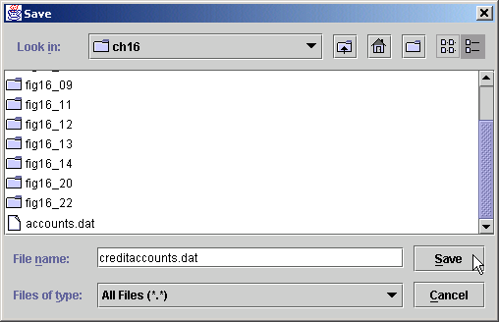
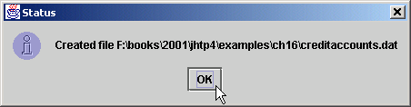
Fig. 16.12 Creating a random-access file sequentially (Part 4).

Slide 57
16.9 Writing Data Randomly to a Random-Access File
RandomAccessFile method seek
  Determines location in file where record is stored
  Sets file-position pointer to a specific point in file

Slide 58
Fig. 16.13 Writing data randomly to a random-access file.
1 // Fig. 16.13: WriteRandomFile.java
2 // This program uses textfields to get information from the
3 // user at the keyboard and writes the information to a
4 // random-access file.
5
6 // Java core packages
7 import java.awt.*;
8 import java.awt.event.*;
9 import java.io.*;
10
11 // Java extension packages
12 import javax.swing.*;
13
14 // Deitel packages
15 import com.deitel.jhtp4.ch16.*;
16
17 public class WriteRandomFile extends JFrame {
18 private RandomAccessFile output;
19 private BankUI userInterface;
20 private JButton enterButton, openButton;
21
22 // set up GUI
23 public WriteRandomFile()
24 {
25 super( "Write to random access file" );
26
27 // create instance of reusable user interface BankUI
28 userInterface = new BankUI( 4 ); // four textfields
29 getContentPane().add( userInterface,
30 BorderLayout.CENTER );
31
32 // get reference to generic task button doTask1 in BankUI
33 openButton = userInterface.getDoTask1Button();
34 openButton.setText( "Open..." );
35

Slide 59
Fig. 16.13 Writing data randomly to a random-access file (Part 2).
36 // register listener to call openFile when button pressed
37 openButton.addActionListener(
38
39 // anonymous inner class to handle openButton event
40 new ActionListener() {
41
42 // allow user to select file to open
43 public void actionPerformed( ActionEvent event )
44 {
45 openFile();
46 }
47
48 } // end anonymous inner class
49
50 ); // end call to addActionListener
51
52 // register window listener for window closing event
53 addWindowListener(
54
55 // anonymous inner class to handle windowClosing event
56 new WindowAdapter() {
57
58 // add record in GUI, then close file
59 public void windowClosing( WindowEvent event )
60 {
61 if ( output != null )
62 addRecord();
63
64 closeFile();
65 }
66
67 } // end anonymous inner class
68
69 ); // end call to addWindowListener
70

Slide 60
Fig. 16.13 Writing data randomly to a random-access file (Part 3).
71 // get reference to generic task button doTask2 in BankUI
72 enterButton = userInterface.getDoTask2Button();
73 enterButton.setText( "Enter" );
74 enterButton.setEnabled( false );
75
76 // register listener to call addRecord when button pressed
77 enterButton.addActionListener(
78
79 // anonymous inner class to handle enterButton event
80 new ActionListener() {
81
82 // add record to file
83 public void actionPerformed( ActionEvent event )
84 {
85 addRecord();
86 }
87
88 } // end anonymous inner class
89
90 ); // end call to addActionListener
91
92 setSize( 300, 150 );
93 show();
94 }
95
96 // enable user to choose file to open
97 private void openFile()
98 {
99 // display file dialog so user can select file
100 JFileChooser fileChooser = new JFileChooser();
101 fileChooser.setFileSelectionMode(
102 JFileChooser.FILES_ONLY );
103
104 int result = fileChooser.showOpenDialog( this );
105

Slide 61
Fig. 16.13 Writing data randomly to a random-access file (Part 4).
106 // if user clicked Cancel button on dialog, return
107 if ( result == JFileChooser.CANCEL_OPTION )
108 return;
109
110 // obtain selected file
111 File fileName = fileChooser.getSelectedFile();
112
113 // display error if file name invalid
114 if ( fileName == null ||
115 fileName.getName().equals( "" ) )
116 JOptionPane.showMessageDialog( this,
117 "Invalid File Name", "Invalid File Name",
118 JOptionPane.ERROR_MESSAGE );
119
120 else {
121
122 // open file
123 try {
124 output = new RandomAccessFile( fileName, "rw" );
125 enterButton.setEnabled( true );
126 openButton.setEnabled( false );
127 }
128
129 // process exception while opening file
130 catch ( IOException ioException ) {
131 JOptionPane.showMessageDialog( this,
132 "File does not exist",
133 "Invalid File Name",
134 JOptionPane.ERROR_MESSAGE );
135 }
136 }
137
138 } // end method openFile
139

Slide 62
Fig. 16.13 Writing data randomly to a random-access file (Part 5).
Lines 162-207
140 // close file and terminate application
141 private void closeFile()
142 {
143 // close file and exit
144 try {
145 if ( output != null )
146 output.close();
147
148 System.exit( 0 );
149 }
150
151 // process exception while closing file
152 catch( IOException ioException ) {
153 JOptionPane.showMessageDialog( this,
154 "Error closing file",
155 "Error", JOptionPane.ERROR_MESSAGE );
156
157 System.exit( 1 );
158 }
159 }
160
161 // add one record to file
162 public void addRecord()
163 {
164 int accountNumber = 0;
165 String fields[] = userInterface.getFieldValues();
166 RandomAccessAccountRecord record =
167 new RandomAccessAccountRecord();
168
169 // ensure account field has a value
170 if ( ! fields[ BankUI.ACCOUNT ].equals( "" ) ) {
171
172 // output values to file
173 try {
174 accountNumber =
Method addRecord retrieves data from the GUI, stores the data in a record and writes the data to a file

Slide 63
Fig. 16.13 Writing data randomly to a random-access file (Part 6).
175 Integer.parseInt( fields[ BankUI.ACCOUNT ] );
176
177 if ( accountNumber > 0 && accountNumber <= 100 ) {
178 record.setAccount( accountNumber );
179
180 record.setFirstName( fields[ BankUI.FIRSTNAME ] );
181 record.setLastName( fields[ BankUI.LASTNAME ] );
182 record.setBalance( Double.parseDouble(
183 fields[ BankUI.BALANCE ] ) );
184
185 output.seek( ( accountNumber - 1 ) *
186 RandomAccessAccountRecord.size() );
187 record.write( output );
188 }
189
190 userInterface.clearFields(); // clear TextFields
191 }
192
193 // process improper account number or balance format
194 catch ( NumberFormatException formatException ) {
195 JOptionPane.showMessageDialog( this,
196 "Bad account number or balance",
197 "Invalid Number Format",
198 JOptionPane.ERROR_MESSAGE );
199 }
200
201 // process exceptions while writing to file
202 catch ( IOException ioException ) {
203 closeFile();
204 }
205 }
206
207 } // end method addRecord
208
Method seeks positions file-position pointer for object output to the proper byte location

Slide 64
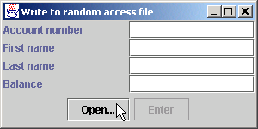
Fig. 16.13 Writing data randomly to a random-access file (Part 7).
209 // execute application
210 public static void main( String args[] )
211 {
212 new WriteRandomFile();
213 }
214
215 } // end class WriteRandomFile

Slide 65
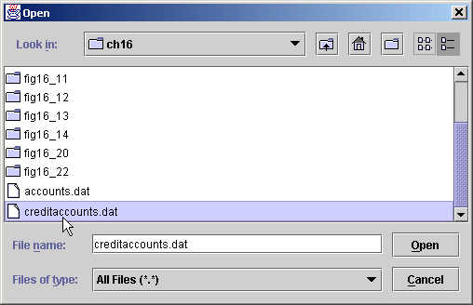
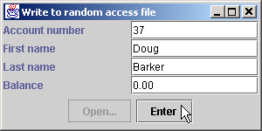
Fig. 16.13 Writing data randomly to a random-access file (Part 8).

Slide 66
16.10 Reading Data Sequentially from a Random-Access File
Read all valid records in a RandomAccessFile

Slide 67
Fig. 16.14 Reading a random-access file sequentially.
1 // Fig. 16.14: ReadRandomFile.java
2 // This program reads a random-access file sequentially and
3 // displays the contents one record at a time in text fields.
4
5 // Java core packages
6 import java.awt.*;
7 import java.awt.event.*;
8 import java.io.*;
9 import java.text.DecimalFormat;
10
11 // Java extension packages
12 import javax.swing.*;
13
14 // Deitel packages
15 import com.deitel.jhtp4.ch16.*;
16
17 public class ReadRandomFile extends JFrame {
18 private BankUI userInterface;
19 private RandomAccessFile input;
20 private JButton nextButton, openButton;
21
22 // set up GUI
23 public ReadRandomFile()
24 {
25 super( "Read Client File" );
26
27 // create reusable user interface instance
28 userInterface = new BankUI( 4 ); // four textfields
29 getContentPane().add( userInterface );
30
31 // configure generic doTask1 button from BankUI
32 openButton = userInterface.getDoTask1Button();
33 openButton.setText( "Open File for Reading..." );
34
35 // register listener to call openFile when button pressed

Slide 68
Fig. 16.14 Reading a random-access file sequentially (Part 2).
36 openButton.addActionListener(
37
38 // anonymous inner class to handle openButton event
39 new ActionListener() {
40
41 // enable user to select file to open
42 public void actionPerformed( ActionEvent event )
43 {
44 openFile();
45 }
46
47 } // end anonymous inner class
48
49 ); // end call to addActionListener
50
51 // configure generic doTask2 button from BankUI
52 nextButton = userInterface.getDoTask2Button();
53 nextButton.setText( "Next" );
54 nextButton.setEnabled( false );
55
56 // register listener to call readRecord when button pressed
57 nextButton.addActionListener(
58
59 // anonymous inner class to handle nextButton event
60 new ActionListener() {
61
62 // read a record when user clicks nextButton
63 public void actionPerformed( ActionEvent event )
64 {
65 readRecord();
66 }
67
68 } // end anonymous inner class
69
70 ); // end call to addActionListener

Slide 69
Fig. 16.14 Reading a random-access file sequentially (Part 3).
71
72 // register listener for window closing event
73 addWindowListener(
74
75 // anonymous inner class to handle windowClosing event
76 new WindowAdapter() {
77
78 // close file and terminate application
79 public void windowClosing( WindowEvent event )
80 {
81 closeFile();
82 }
83
84 } // end anonymous inner class
85
86 ); // end call to addWindowListener
87
88 setSize( 300, 150 );
89 show();
90 }
91
92 // enable user to select file to open
93 private void openFile()
94 {
95 // display file dialog so user can select file
96 JFileChooser fileChooser = new JFileChooser();
97 fileChooser.setFileSelectionMode(
98 JFileChooser.FILES_ONLY );
99
100 int result = fileChooser.showOpenDialog( this );
101
102 // if user clicked Cancel button on dialog, return
103 if ( result == JFileChooser.CANCEL_OPTION )
104 return;
105

Slide 70
Fig. 16.14 Reading a random-access file sequentially (Part 4).
Lines 136-174
106 // obtain selected file
107 File fileName = fileChooser.getSelectedFile();
108
109 // display error is file name invalid
110 if ( fileName == null ||
111 fileName.getName().equals( "" ) )
112 JOptionPane.showMessageDialog( this,
113 "Invalid File Name", "Invalid File Name",
114 JOptionPane.ERROR_MESSAGE );
115
116 else {
117
118 // open file
119 try {
120 input = new RandomAccessFile( fileName, "r" );
121 nextButton.setEnabled( true );
122 openButton.setEnabled( false );
123 }
124
125 // catch exception while opening file
126 catch ( IOException ioException ) {
127 JOptionPane.showMessageDialog( this,
128 "File does not exist", "Invalid File Name",
129 JOptionPane.ERROR_MESSAGE );
130 }
131 }
132
133 } // end method openFile
134
135 // read one record
136 public void readRecord()
137 {
138 DecimalFormat twoDigits = new DecimalFormat( "0.00" );
139 RandomAccessAccountRecord record =
140 new RandomAccessAccountRecord();
Method readRecord reads through file until it finds a valid account record

Slide 71
Fig. 16.14 Reading a random-access file sequentially (Part 5).
Line 146
141
142 // read a record and display
143 try {
144
145 do {
146 record.read( input );
147 } while ( record.getAccount() == 0 );
148
149 String values[] = {
150 String.valueOf( record.getAccount() ),
151 record.getFirstName(),
152 record.getLastName(),
153 String.valueOf( record.getBalance() ) };
154 userInterface.setFieldValues( values );
155 }
156
157 // close file when end-of-file reached
158 catch ( EOFException eofException ) {
159 JOptionPane.showMessageDialog( this, "No more records",
160 "End-of-file reached",
161 JOptionPane.INFORMATION_MESSAGE );
162 closeFile();
163 }
164
165 // process exceptions from problem with file
166 catch ( IOException ioException ) {
167 JOptionPane.showMessageDialog( this,
168 "Error Reading File", "Error",
169 JOptionPane.ERROR_MESSAGE );
170
171 System.exit( 1 );
172 }
173
174 } // end method readRecord
175
Invoke method read to read data into record object

Slide 72
Fig. 16.14 Reading a random-access file sequentially (Part 6).
176 // close file and terminate application
177 private void closeFile()
178 {
179 // close file and exit
180 try {
181 if ( input != null )
182 input.close();
183
184 System.exit( 0 );
185 }
186
187 // process exception closing file
188 catch( IOException ioException ) {
189 JOptionPane.showMessageDialog( this,
190 "Error closing file",
191 "Error", JOptionPane.ERROR_MESSAGE );
192
193 System.exit( 1 );
194 }
195 }
196
197 // execute application
198 public static void main( String args[] )
199 {
200 new ReadRandomFile();
201 }
202
203 } // end class ReadRandomFile

Slide 73
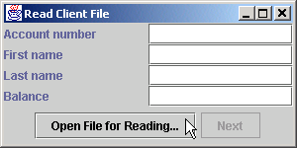
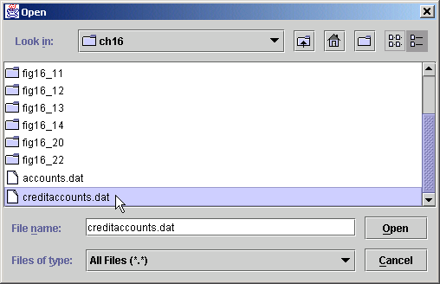
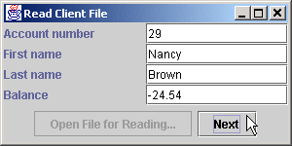
Fig. 16.14 Reading a random-access file sequentially (Part 7).

Slide 74
16.11 Example: A Transaction-Processing Program
Substantial transaction-processing system
  Uses random-access file
  Updates, adds and deletes accounts

Slide 75
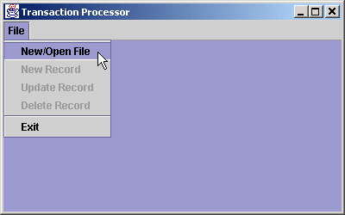
Fig. 16.15 The initial Transaction Processor window.

Slide 76
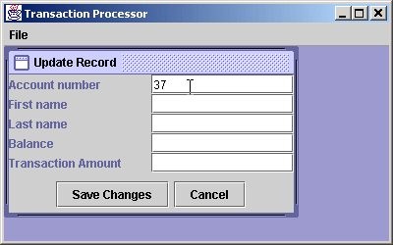
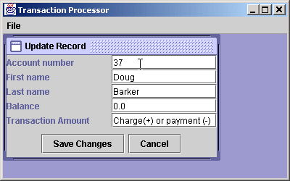
Fig. 16.16 Loading a record into the Update Record internal frame.
Type account number and press the Enter key to load record.

Slide 77
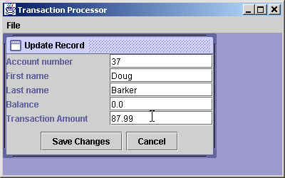
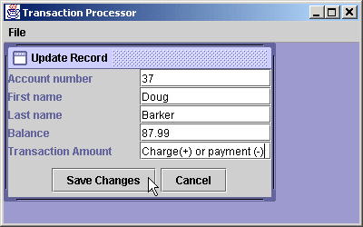
Fig. 16.17 Inputting a transaction in the Update Record internal frame.
Type transaction amount and press the Enter key to update balance in dialog.
Press Save Changes to store new balance in file.

Slide 78
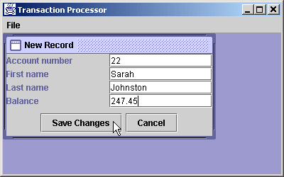
16.18 New Record internal frame.

Slide 79
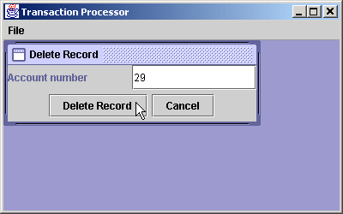
16.19 Delete Record internal frame.

Slide 80
Fig. 16.20 Transaction-processing program.
1 // Transaction processing program using RandomAccessFiles.
2 // This program reads a random-access file sequentially,
3 // updates records already written to the file, creates new
4 // records to be placed in the file and deletes data
5 // already in the file.
6
7 // Java core packages
8 import java.awt.*;
9 import java.awt.event.*;
10 import java.io.*;
11 import java.text.DecimalFormat;
12
13 // Java extension packages
14 import javax.swing.*;
15
16 // Deitel packages
17 import com.deitel.jhtp4.ch16.*;
18
19 public class TransactionProcessor extends JFrame {
20 private UpdateDialog updateDialog;
21 private NewDialog newDialog;
22 private DeleteDialog deleteDialog;
23 private JMenuItem newItem, updateItem, deleteItem,
24 openItem, exitItem;
25 private JDesktopPane desktop;
26 private RandomAccessFile file;
27 private RandomAccessAccountRecord record;
28
29 // set up GUI
30 public TransactionProcessor()
31 {
32 super( "Transaction Processor" );
33

Slide 81
Fig. 16.20 Transaction-processing program (Part 2).
34 // set up desktop, menu bar and File menu
35 desktop = new JDesktopPane();
36 getContentPane().add( desktop );
37
38 JMenuBar menuBar = new JMenuBar();
39 setJMenuBar( menuBar );
40
41 JMenu fileMenu = new JMenu( "File" );
42 menuBar.add( fileMenu );
43
44 // set up menu item for adding a record
45 newItem = new JMenuItem( "New Record" );
46 newItem.setEnabled( false );
47
48 // display new record dialog when user selects New Record
49 newItem.addActionListener(
50
51 new ActionListener() {
52
53 public void actionPerformed( ActionEvent event )
54 {
55 newDialog.setVisible( true );
56 }
57 }
58 );
59
60 // set up menu item for updating a record
61 updateItem = new JMenuItem( "Update Record" );
62 updateItem.setEnabled( false );
63
64 // display update dialog when user selects Update Record
65 updateItem.addActionListener(
66
67 new ActionListener() {
68

Slide 82
Fig. 16.20 Transaction-processing program (Part 3).
69 public void actionPerformed( ActionEvent event )
70 {
71 updateDialog.setVisible( true );
72 }
73 }
74 );
75
76 // set up menu item for deleting a record
77 deleteItem = new JMenuItem( "Delete Record" );
78 deleteItem.setEnabled( false );
79
80 // display delete dialog when user selects Delete Record
81 deleteItem.addActionListener(
82
83 new ActionListener() {
84
85 public void actionPerformed( ActionEvent event )
86 {
87 deleteDialog.setVisible( true );
88 }
89 }
90 );
91
92 // set up button for opening file
93 openItem = new JMenuItem( "New/Open File" );
94
95 // enable user to select file to open, then set up
96 // dialog boxes
97 openItem.addActionListener(
98
99 new ActionListener() {
100

Slide 83
Fig. 16.20 Transaction-processing program (Part 4).
101 public void actionPerformed( ActionEvent event )
102 {
103 boolean opened = openFile();
104
105 if ( !opened )
106 return;
107
108 openItem.setEnabled( false );
109
110 // set up internal frames for record processing
111 updateDialog = new UpdateDialog( file );
112 desktop.add( updateDialog );
113
114 deleteDialog = new DeleteDialog( file );
115 desktop.add ( deleteDialog );
116
117 newDialog = new NewDialog( file );
118 desktop.add( newDialog );
119 }
120
121 } // end anonymous inner class
122
123 ); // end call to addActionListener
124
125 // set up menu item for exiting program
126 exitItem = new JMenuItem( "Exit" );
127 exitItem.setEnabled( true );
128
129 // teminate application
130 exitItem.addActionListener(
131
132 new ActionListener() {
133

Slide 84
Fig. 16.20 Transaction-processing program (Part 5).
134 public void actionPerformed( ActionEvent event )
135 {
136 closeFile();
137 }
138 }
139 );
140
141 // attach menu items to File menu
142 fileMenu.add( openItem );
143 fileMenu.add( newItem );
144 fileMenu.add( updateItem );
145 fileMenu.add( deleteItem );
146 fileMenu.addSeparator();
147 fileMenu.add( exitItem );
148
149 // configure window
150 setDefaultCloseOperation(
151 WindowConstants.DO_NOTHING_ON_CLOSE );
152
153 setSize( 400, 250 );
154 setVisible( true );
155
156 } // end TransactionProcessor constructor
157
158 // enable user to select file to open
159 private boolean openFile()
160 {
161 // display dialog so user can select file
162 JFileChooser fileChooser = new JFileChooser();
163 fileChooser.setFileSelectionMode(
164 JFileChooser.FILES_ONLY );
165
166 int result = fileChooser.showOpenDialog( this );
167

Slide 85
Fig. 16.20 Transaction-processing program (Part 6).
168 // if user clicked Cancel button on dialog, return
169 if ( result == JFileChooser.CANCEL_OPTION )
170 return false;
171
172 // obtain selected file
173 File fileName = fileChooser.getSelectedFile();
174
175 // display error if file name invalid
176 if ( fileName == null ||
177 fileName.getName().equals( "" ) ) {
178 JOptionPane.showMessageDialog( this,
179 "Invalid File Name", "Invalid File Name",
180 JOptionPane.ERROR_MESSAGE );
181
182 return false;
183 }
184
185 else {
186
187 // open file
188 try {
189 file = new RandomAccessFile( fileName, "rw" );
190 openItem.setEnabled( false );
191 newItem.setEnabled( true );
192 updateItem.setEnabled( true );
193 deleteItem.setEnabled( true );
194 }
195
196 // process problems opening file
197 catch ( IOException ioException ) {
198 JOptionPane.showMessageDialog( this,
199 "File does not exist", "Invalid File Name",
200 JOptionPane.ERROR_MESSAGE );
201

Slide 86
Fig. 16.20 Transaction-processing program (Part 7).
202 return false;
203 }
204 }
205
206 return true; // file opened
207 }
208
209 // close file and terminate application
210 private void closeFile()
211 {
212 // close file and exit
213 try {
214 if ( file != null )
215 file.close();
216
217 System.exit( 0 );
218 }
219
220 // process exceptions closing file
221 catch( IOException ioException ) {
222 JOptionPane.showMessageDialog( this,
223 "Error closing file",
224 "Error", JOptionPane.ERROR_MESSAGE );
225 System.exit( 1 );
226 }
227 }
228
229 // execute application
230 public static void main( String args[] )
231 {
232 new TransactionProcessor();
233 }
234
235 } // end class TransactionProcessor
236

Slide 87
Fig. 16.20 Transaction-processing program (Part 8).
Lines 238-458
Class UpdateDialog implements Update Record internal frame
237 // class for udpating records
238 class UpdateDialog extends JInternalFrame {
239 private RandomAccessFile file;
240 private BankUI userInterface;
241
242 // set up GUI
243 public UpdateDialog( RandomAccessFile updateFile )
244 {
245 super( "Update Record" );
246
247 file = updateFile;
248
249 // set up GUI components
250 userInterface = new BankUI( 5 );
251 getContentPane().add( userInterface,
252 BorderLayout.CENTER );
253
254 // set up Save Changes button and register listener
255 JButton saveButton = userInterface.getDoTask1Button();
256 saveButton.setText( "Save Changes" );
257
258 saveButton.addActionListener(
259
260 new ActionListener() {
261
262 public void actionPerformed( ActionEvent event )
263 {
264 addRecord( getRecord() );
265 setVisible( false );
266 userInterface.clearFields();
267 }
268 }
269 );
270

Slide 88
Fig. 16.20 Transaction-processing program (Part 9).
Lines 295-330
271 // set up Cancel button and register listener
272 JButton cancelButton = userInterface.getDoTask2Button();
273 cancelButton.setText( "Cancel" );
274
275 cancelButton.addActionListener(
276
277 new ActionListener() {
278
279 public void actionPerformed( ActionEvent event )
280 {
281 setVisible( false );
282 userInterface.clearFields();
283 }
284 }
285 );
286
287 // set up listener for transaction textfield
288 JTextField transactionField =
289 userInterface.getFields()[ BankUI.TRANSACTION ];
290
291 transactionField.addActionListener(
292
293 new ActionListener() {
294
295 public void actionPerformed( ActionEvent event )
296 {
297 // add transaction amount to balance
298 try {
299 RandomAccessAccountRecord record = getRecord();
300
301 // get textfield values from userInterface
302 String fieldValues[] =
303 userInterface.getFieldValues();
304
Method actionPerformed processes a transaction in the current account

Slide 89
Fig. 16.20 Transaction-processing program (Part 10).
305 // get transaction amount
306 double change = Double.parseDouble(
307 fieldValues[ BankUI.TRANSACTION ] );
308
309 // specify Strings to display in GUI
310 String[] values = {
311 String.valueOf( record.getAccount() ),
312 record.getFirstName(),
313 record.getLastName(),
314 String.valueOf( record.getBalance()
315 + change ),
316 "Charge(+) or payment (-)" };
317
318 // display Strings in GUI
319 userInterface.setFieldValues( values );
320 }
321
322 // process invalid number in transaction field
323 catch ( NumberFormatException numberFormat ) {
324 JOptionPane.showMessageDialog( null,
325 "Invalid Transaction",
326 "Invalid Number Format",
327 JOptionPane.ERROR_MESSAGE );
328 }
329
330 } // end method actionPerformed
331
332 } // end anonymous inner class
333
334 ); // end call to addActionListener
335
336 // set up listener for account text field
337 JTextField accountField =
338 userInterface.getFields()[ BankUI.ACCOUNT ];
339

Slide 90
Fig. 16.20 Transaction-processing program (Part 11).
Lines 345-360
Lines 350- 357
Lines 371-418
340 accountField.addActionListener(
341
342 new ActionListener() {
343
344 // get record and display contents in GUI
345 public void actionPerformed( ActionEvent event )
346 {
347 RandomAccessAccountRecord record = getRecord();
348
349 if ( record.getAccount() != 0 ) {
350 String values[] = {
351 String.valueOf( record.getAccount() ),
352 record.getFirstName(),
353 record.getLastName(),
354 String.valueOf( record.getBalance() ),
355 "Charge(+) or payment (-)" };
356
357 userInterface.setFieldValues( values );
358 }
359
360 } // end method actionPerformed
361
362 } // end anonymous inner class
363
364 ); // end call to addActionListener
365
366 setSize( 300, 175 );
367 setVisible( false );
368 }
369
370 // get record from file
371 private RandomAccessAccountRecord getRecord()
372 {
373 RandomAccessAccountRecord record =
374 new RandomAccessAccountRecord();
Method actionPerformed uses number entered in a JTextField to retrieve a record from file with method getRecord
Extract record information and display in internal frame
Method getRecord reads record from file

Slide 91
Fig. 16.20 Transaction-processing program (Part 12).
305
376 // get record from file
377 try {
378 JTextField accountField =
379 userInterface.getFields()[ BankUI.ACCOUNT ];
380
381 int accountNumber =
382 Integer.parseInt( accountField.getText() );
383
384 if ( accountNumber < 1 || accountNumber > 100 ) {
385 JOptionPane.showMessageDialog( this,
386 "Account Does Not Exist",
387 "Error", JOptionPane.ERROR_MESSAGE );
388 return record;
389 }
390
391 // seek to appropriate record location in file
392 file.seek( ( accountNumber - 1 ) *
393 RandomAccessAccountRecord.size() );
394 record.read( file );
395
396 if ( record.getAccount() == 0 )
397 JOptionPane.showMessageDialog( this,
398 "Account Does Not Exist",
399 "Error", JOptionPane.ERROR_MESSAGE );
400 }
401
402 // process invalid account number format
403 catch ( NumberFormatException numberFormat ) {
404 JOptionPane.showMessageDialog( this,
405 "Invalid Account", "Invalid Number Format",
406 JOptionPane.ERROR_MESSAGE );
407 }
408

Slide 92
Fig. 16.20 Transaction-processing program (Part 13).
Lines 421-456
409 // process file processing problems
410 catch ( IOException ioException ) {
411 JOptionPane.showMessageDialog( this,
412 "Error Reading File",
413 "Error", JOptionPane.ERROR_MESSAGE );
414 }
415
416 return record;
417
418 } // end method getRecord
419
420 // add record to file
421 public void addRecord( RandomAccessAccountRecord record )
422 {
423 // update record in file
424 try {
425 int accountNumber = record.getAccount();
426
427 file.seek( ( accountNumber - 1 ) *
428 RandomAccessAccountRecord.size() );
429
430 String[] values = userInterface.getFieldValues();
431
432 // set firstName, lastName and balance in record
433 record.setFirstName( values[ BankUI.FIRSTNAME ] );
434 record.setLastName( values[ BankUI.LASTNAME ] );
435 record.setBalance(
436 Double.parseDouble( values[ BankUI.BALANCE ] ) );
437
438 // rewrite record to file
439 record.write( file );
440 }
441
Method addRecord updates the current balance

Slide 93
Fig. 16.20 Transaction-processing program (Part 14).
Lines 461-615
442 // process file processing problems
443 catch ( IOException ioException ) {
444 JOptionPane.showMessageDialog( this,
445 "Error Writing To File",
446 "Error", JOptionPane.ERROR_MESSAGE );
447 }
448
449 // process invalid balance value
450 catch ( NumberFormatException numberFormat ) {
451 JOptionPane.showMessageDialog( this,
452 "Bad Balance", "Invalid Number Format",
453 JOptionPane.ERROR_MESSAGE );
454 }
455
456 } // end method addRecord
457
458 } // end class UpdateDialog
459
460 // class for creating new records
461 class NewDialog extends JInternalFrame {
462 private RandomAccessFile file;
463 private BankUI userInterface;
464
465 // set up GUI
466 public NewDialog( RandomAccessFile newFile )
467 {
468 super( "New Record" );
469
470 file = newFile;
471
472 // attach user interface to dialog
473 userInterface = new BankUI( 4 );
474 getContentPane().add( userInterface,
475 BorderLayout.CENTER );
476
Class NewDialog implements the New Record internal frame

Slide 94
Fig. 16.20 Transaction-processing program (Part 15).
477 // set up Save Changes button and register listener
478 JButton saveButton = userInterface.getDoTask1Button();
479 saveButton.setText( "Save Changes" );
480
481 saveButton.addActionListener(
482
483 new ActionListener() {
484
485 // add new record to file
486 public void actionPerformed( ActionEvent event )
487 {
488 addRecord( getRecord() );
489 setVisible( false );
490 userInterface.clearFields();
491 }
492
493 } // end anonymous inner class
494
495 ); // end call to addActionListener
496
497 JButton cancelButton = userInterface.getDoTask2Button();
498 cancelButton.setText( "Cancel" );
499
500 cancelButton.addActionListener(
501
502 new ActionListener() {
503
504 // dismiss dialog without storing new record
505 public void actionPerformed( ActionEvent event )
506 {
507 setVisible( false );
508 userInterface.clearFields();
509 }
510
511 } // end anonymous inner class

Slide 95
Fig. 16.20 Transaction-processing program (Part 16).
512
513 ); // end call to addActionListener
514
515 setSize( 300, 150 );
516 setVisible( false );
517
518 } // end constructor
519
520 // get record from file
521 private RandomAccessAccountRecord getRecord()
522 {
523 RandomAccessAccountRecord record =
524 new RandomAccessAccountRecord();
525
526 // get record from file
527 try {
528 JTextField accountField =
529 userInterface.getFields()[ BankUI.ACCOUNT ];
530
531 int accountNumber =
532 Integer.parseInt( accountField.getText() );
533
534 if ( accountNumber < 1 || accountNumber > 100 ) {
535 JOptionPane.showMessageDialog( this,
536 "Account Does Not Exist",
537 "Error", JOptionPane.ERROR_MESSAGE );
538 return record;
539 }
540
541 // seek to record location
542 file.seek( ( accountNumber - 1 ) *
543 RandomAccessAccountRecord.size() );
544

Slide 96
Fig. 16.20 Transaction-processing program (Part 17).
545 // read record from file
546 record.read( file );
547 }
548
549 // process invalid account number format
550 catch ( NumberFormatException numberFormat ) {
551 JOptionPane.showMessageDialog( this,
552 "Account Does Not Exist", "Invalid Number Format",
553 JOptionPane.ERROR_MESSAGE );
554 }
555
556 // process file processing problems
557 catch ( IOException ioException ) {
558 JOptionPane.showMessageDialog( this,
559 "Error Reading File",
560 "Error", JOptionPane.ERROR_MESSAGE );
561 }
562
563 return record;
564
565 } // end method getRecord
566
567 // add record to file
568 public void addRecord( RandomAccessAccountRecord record )
569 {
570 String[] fields = userInterface.getFieldValues();
571
572 if ( record.getAccount() != 0 ) {
573 JOptionPane.showMessageDialog( this,
574 "Record Already Exists",
575 "Error", JOptionPane.ERROR_MESSAGE );
576 return;
577 }
578

Slide 97
Fig. 16.20 Transaction-processing program (Part 18).
579 // output the values to the file
580 try {
581
582 // set account, first name, last name and balance
583 // for record
584 record.setAccount( Integer.parseInt(
585 fields[ BankUI.ACCOUNT ] ) );
586 record.setFirstName( fields[ BankUI.FIRSTNAME ] );
587 record.setLastName( fields[ BankUI.LASTNAME ] );
588 record.setBalance( Double.parseDouble(
589 fields[ BankUI.BALANCE ] ) );
590
591 // seek to record location
592 file.seek( ( record.getAccount() - 1 ) *
593 RandomAccessAccountRecord.size() );
594
595 // write record
596 record.write( file );
597 }
598
599 // process invalid account or balance format
600 catch ( NumberFormatException numberFormat ) {
601 JOptionPane.showMessageDialog( this,
602 "Invalid Balance", "Invalid Number Format",
603 JOptionPane.ERROR_MESSAGE );
604 }
605
606 // process file processing problems
607 catch ( IOException ioException ) {
608 JOptionPane.showMessageDialog( this,
609 "Error Writing To File",
610 "Error", JOptionPane.ERROR_MESSAGE );
611 }
612
613 } // end method addRecord

Slide 98
Fig. 16.20 Transaction-processing program (Part 19).
Lines 618-774
Class DeleteDialog implements the Delete Record internal frame
614
615 } // end class NewDialog
616
617 // class for deleting records
618 class DeleteDialog extends JInternalFrame {
619 private RandomAccessFile file; // file for output
620 private BankUI userInterface;
621
622 // set up GUI
623 public DeleteDialog( RandomAccessFile deleteFile )
624 {
625 super( "Delete Record" );
626
627 file = deleteFile;
628
629 // create BankUI with only account field
630 userInterface = new BankUI( 1 );
631
632 getContentPane().add( userInterface,
633 BorderLayout.CENTER );
634
635 // set up Delete Record button and register listener
636 JButton deleteButton = userInterface.getDoTask1Button();
637 deleteButton.setText( "Delete Record" );
638
639 deleteButton.addActionListener(
640
641 new ActionListener() {
642

Slide 99
Fig. 16.20 Transaction-processing program (Part 20).
643 // overwrite existing record
644 public void actionPerformed( ActionEvent event )
645 {
646 addRecord( getRecord() );
647 setVisible( false );
648 userInterface.clearFields();
649 }
650
651 } // end anonymous inner class
652
653 ); // end call to addActionListener
654
655 // set up Cancel button and register listener
656 JButton cancelButton = userInterface.getDoTask2Button();
657 cancelButton.setText( "Cancel" );
658
659 cancelButton.addActionListener(
660
661 new ActionListener() {
662
663 // cancel delete operation by hiding dialog
664 public void actionPerformed( ActionEvent event )
665 {
666 setVisible( false );
667 }
668
669 } // end anonymous inner class
670
671 ); // end call to addActionListener
672
673 // set up listener for account text field
674 JTextField accountField =
675 userInterface.getFields()[ BankUI.ACCOUNT ];

Slide 100
Fig. 16.20 Transaction-processing program (Part 21).
676
677 accountField.addActionListener(
678
679 new ActionListener() {
680
681 public void actionPerformed( ActionEvent event )
682 {
683 RandomAccessAccountRecord record = getRecord();
684 }
685
686 } // end anonymous inner class
687
688 ); // end call to addActionListener
689
690 setSize( 300, 100 );
691 setVisible( false );
692
693 } // end constructor
694
695 // get record from file
696 private RandomAccessAccountRecord getRecord()
697 {
698 RandomAccessAccountRecord record =
699 new RandomAccessAccountRecord();
700
701 // get record from file
702 try {
703 JTextField accountField =
704 userInterface.getFields()[ BankUI.ACCOUNT ];
705
706 int accountNumber =
707 Integer.parseInt( accountField.getText() );

Slide 101
Fig. 16.20 Transaction-processing program (Part 22).
708
709 if ( accountNumber < 1 || accountNumber > 100 ) {
710 JOptionPane.showMessageDialog( this,
711 "Account Does Not Exist",
712 "Error", JOptionPane.ERROR_MESSAGE );
713 return( record );
714 }
715
716 // seek to record location and read record
717 file.seek( ( accountNumber - 1 ) *
718 RandomAccessAccountRecord.size() );
719 record.read( file );
720
721 if ( record.getAccount() == 0 )
722 JOptionPane.showMessageDialog( this,
723 "Account Does Not Exist",
724 "Error", JOptionPane.ERROR_MESSAGE );
725 }
726
727 // process invalid account number format
728 catch ( NumberFormatException numberFormat ) {
729 JOptionPane.showMessageDialog( this,
730 "Account Does Not Exist",
731 "Invalid Number Format",
732 JOptionPane.ERROR_MESSAGE );
733 }
734
735 // process file processing problems
736 catch ( IOException ioException ) {
737 JOptionPane.showMessageDialog( this,
738 "Error Reading File",
739 "Error", JOptionPane.ERROR_MESSAGE );
740 }

Slide 102
Fig. 16.20 Transaction-processing program (Part 23).
741
742 return record;
743
744 } // end method getRecord
745
746 // add record to file
747 public void addRecord( RandomAccessAccountRecord record )
748 {
749 if ( record.getAccount() == 0 )
750 return;
751
752 // delete record by setting account number to 0
753 try {
754 int accountNumber = record.getAccount();
755
756 // seek to record position
757 file.seek( ( accountNumber - 1 ) *
758 RandomAccessAccountRecord.size() );
759
760 // set account to 0 and overwrite record
761 record.setAccount( 0 );
762 record.write( file );
763 }
764
765 // process file processing problems
766 catch ( IOException ioException ) {
767 JOptionPane.showMessageDialog( this,
768 "Error Writing To File",
769 "Error", JOptionPane.ERROR_MESSAGE );
770 }
771
772 } // end method addRecord
773
774 } // end class DeleteDialog

Slide 103
16.12 Class File
Class File
  Provides useful information about a file or directory
  Does not open files or process files
Fig. 16.21 lists some useful File methods

Slide 104
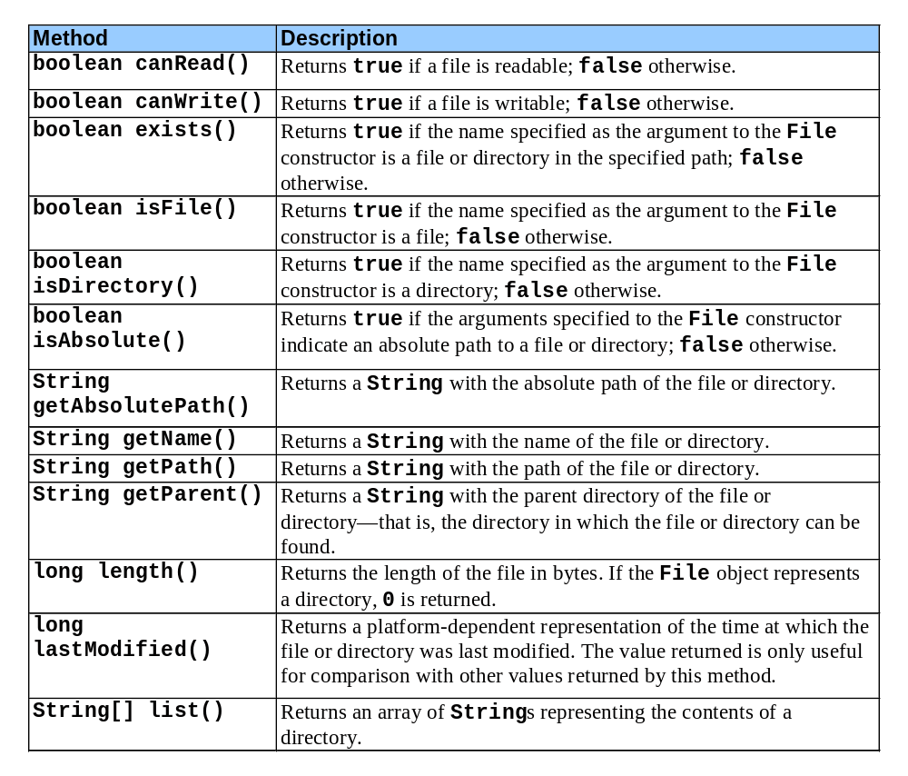
Fig. 16.21 Some commonly used File methods.

Slide 105
Fig. 16.22 Demonstrating class File.
1 // Fig. 16.22: FileTest.java
2 // Demonstrating the File class.
3
4 // Java core packages
5 import java.awt.*;
6 import java.awt.event.*;
7 import java.io.*;
8
9 // Java extension packages
10 import javax.swing.*;
11
12 public class FileTest extends JFrame
13 implements ActionListener {
14
15 private JTextField enterField;
16 private JTextArea outputArea;
17
18 // set up GUI
19 public FileTest()
20 {
21 super( "Testing class File" );
22
23 enterField = new JTextField(
24 "Enter file or directory name here" );
25 enterField.addActionListener( this );
26 outputArea = new JTextArea();
27
28 ScrollPane scrollPane = new ScrollPane();
29 scrollPane.add( outputArea );
30
31 Container container = getContentPane();
32 container.add( enterField, BorderLayout.NORTH );
33 container.add( scrollPane, BorderLayout.CENTER );
34

Slide 106
Fig. 16.22 Demonstrating class File (Part 2).
Lines 40-103
Lines 45-94
35 setSize( 400, 400 );
36 show();
37 }
38
39 // display information about file user specifies
40 public void actionPerformed( ActionEvent actionEvent )
41 {
42 File name = new File( actionEvent.getActionCommand() );
43
44 // if name exists, output information about it
45 if ( name.exists() ) {
46 outputArea.setText(
47 name.getName() + " exists\n" +
48 ( name.isFile() ?
49 "is a file\n" : "is not a file\n" ) +
50 ( name.isDirectory() ?
51 "is a directory\n" : "is not a directory\n" ) +
52 ( name.isAbsolute() ? "is absolute path\n" :
53 "is not absolute path\n" ) +
54 "Last modified: " + name.lastModified() +
55 "\nLength: " + name.length() +
56 "\nPath: " + name.getPath() +
57 "\nAbsolute path: " + name.getAbsolutePath() +
58 "\nParent: " + name.getParent() );
59
60 // output information if name is a file
61 if ( name.isFile() ) {
62
63 // append contents of file to outputArea
64 try {
65 BufferedReader input = new BufferedReader(
66 new FileReader( name ) );
67 StringBuffer buffer = new StringBuffer();
68 String text;
69 outputArea.append( "\n\n" );
Method actionPerformed creates a new File and assigns it a name
Body of if outputs information about the file if it exists

Slide 107
Fig. 16.22 Demonstrating class File (Part 3).
Lines 97-101
70
71 while ( ( text = input.readLine() ) != null )
72 buffer.append( text + "\n" );
73
74 outputArea.append( buffer.toString() );
75 }
76
77 // process file processing problems
78 catch( IOException ioException ) {
79 JOptionPane.showMessageDialog( this,
80 "FILE ERROR",
81 "FILE ERROR", JOptionPane.ERROR_MESSAGE );
82 }
83 }
84
85 // output directory listing
86 else if ( name.isDirectory() ) {
87 String directory[] = name.list();
88
89 outputArea.append( "\n\nDirectory contents:\n");
90
91 for ( int i = 0; i < directory.length; i++ )
92 outputArea.append( directory[ i ] + "\n" );
93 }
94 }
95
96 // not file or directory, output error message
97 else {
98 JOptionPane.showMessageDialog( this,
99 actionEvent.getActionCommand() + " Does Not Exist",
100 "ERROR", JOptionPane.ERROR_MESSAGE );
101 }
102
103 } // end method actionPerformed
If file does not exist, display error

Slide 108
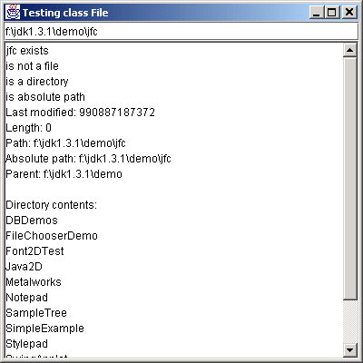
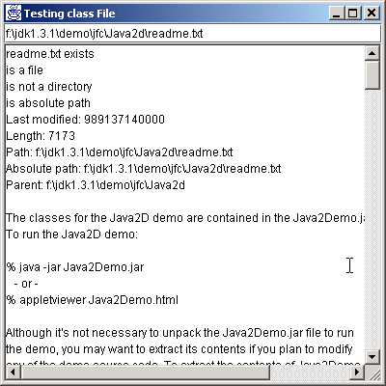
Fig. 16.22 Demonstrating class File (Part 4).
104
105 // execute application
106 public static void main( String args[] )
107 {
108 FileTest application = new FileTest();
109
110 application.setDefaultCloseOperation(
111 JFrame.EXIT_ON_CLOSE );
112 }
113
114 } // end class FileTest

